Slide 1
Playing Pong using DQN and Combined Experience Replay
By Nolan Gutierrez

Slide 2
Problem Statement
What is the goal of this project?
What is the definition of the problem to which our reinforcement algorithm will be applied?
State Space?
Action Space?
Reward Function?
Transition Function?
Why use a function approximator? [1]

Slide 3
Project Overview
Environment
Preprocessing
DQN [1]
Reward Clipping
Combined Experience Replay [2]
Exploration Policy
Results

Slide 4
Environment
What pong implementation was used?
Is it open source?

Slide 5
Preprocessing
Grayscale
Adaptive Thresholding
th2 = cv2.adaptiveThreshold(img,255,cv2.ADAPTIVE_THRESH_MEAN_C, cv2.THRESH_BINARY,11,2)
Image Scaling
Cropping
Normalization

Slide 6
Deep Q-Learning (DQN)
What’s special about deep learning as a Q-value approximator?
What was the original purpose of the DQN? [1]
What is it like to train a DQN?
Model specifications:
Convolutional layer: 32 filters, 4 x 4 strides, kernel size of 8, relu activation function
Max pooling layer: strides 2 by 2, kernel 2 by 2
Convolutional layer: 64 filters, 2 by 2 strides, kernel size of 3, relu activation function
Convolutional layer: 64 filters, 1 by 1 strides, kernel size of 3, relu activation function
Flattened
MLP: 512 output nodes, relu activation function
MLP: 4 output nodes, no activation function
Loss:

Slide 7
DQN Training
adam - lr .00025, beta1 .9, beta2 .99, epsilon 1e-8
Target weights updated every 10000 steps
Maximum number of experiences 300000
Batch Size: 32
Number of Episodes: 600
Last Frame: 1830000

Slide 8
Reward Clipping
What does reward clipping do?
Why use it?
What was the reward function used?

Slide 9
Combined Experience Replay
What benefits come with Combined Experience Replay? [2]
How was it used in this experiment?
Was its usage a success?

Slide 10
Exploration Strategy
The exploration policy used was very simple
epsilon: .05
Time to Start: 100000 frames

Slide 11
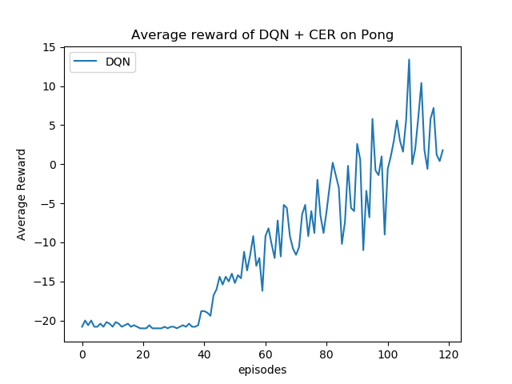
Results

Slide 12
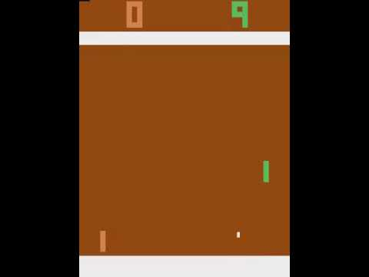
Results
Gameplay

Slide 13
Implementation
Tensorflow v2
Numpy
OpenCV
Pillow
Pybullet-gym
gym
intel i7 8700k P4000 GPU 32 GB RAM
Anaconda
Ubuntu 16.04

Slide 14
References
V. Mnih, K. Kavukcuoglu, D. Silver, A. Graves, I. Antonoglou, D. Wier-stra, and M. Riedmiller, “Playing atari with deep reinforcement learn-ing,” 2013.
S. Zhang and R. S. Sutton, “A deeper look at experience replay,” 2017.

